Slide 1


Dashboard Blueprint
Tableau

Slide 2

Tableau
Easily connects with source data
Efficient in handling large data sets
Interactive on demand visualization
Story telling option combing dashboard & data
Online public access to share information

Slide 3
Interactive Elements of Story
Brewery Locations
Brewery map across USA
Most Popular Beers
Beers with most votes
Review Analysis
Number of yearly reviews
Products by breweries
Types of breweries
Number of reviews by criteria
Popular beers by state
Reviews by locations
Products vs reviews

Slide 4
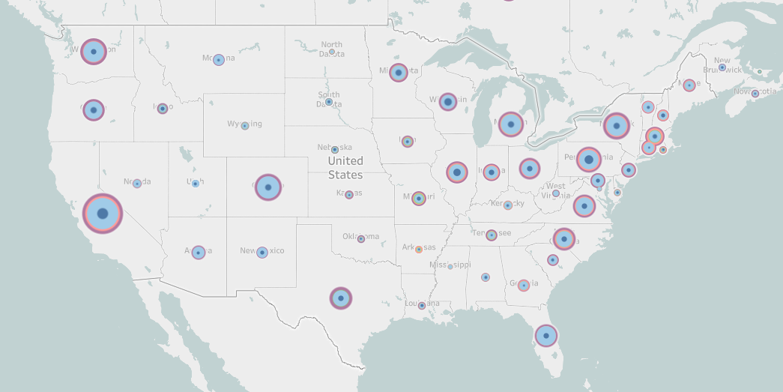
Brewery Locations

Slide 5
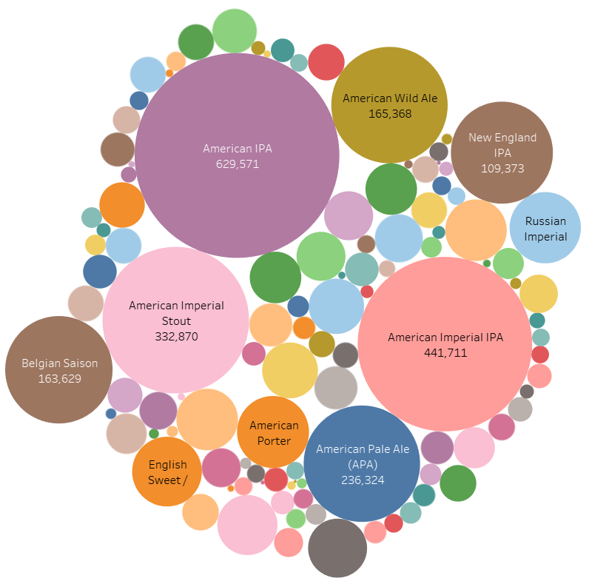
Most Popular Beers

Slide 6
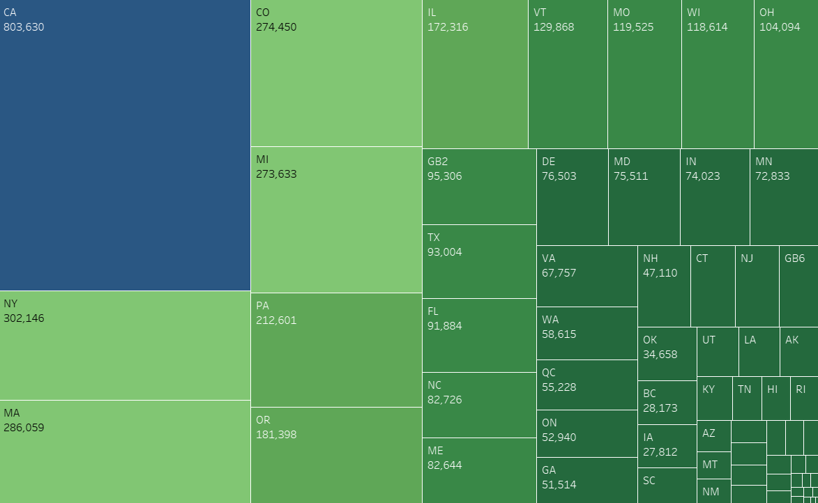
Reviews by Locations

